Slide 1
Circulation Control
Ryan Callahan
Aaron Watson

Slide 2
Purpose
The purpose of this research project is to investigate the effects of circulation control on lift and drag.
Also being investigated is whether drag penalties from circulation control can be reduced by preventing separation off the trailing edge, thereby reducing the size of the wake.

Slide 3
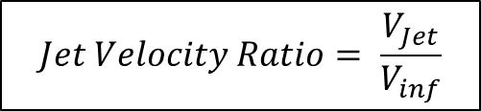
Background
Circulation control is a form of high lift device implemented on the main wing of an aircraft.
If the jet has high enough jet velocity ratio, it will emerge with a pressure lower than static which will allow the jet to attach to the trailing edge of the wing. This phenomenon is called the Coenda Effect.
$$Jet Velocity Ratio= \frac{V_{Jet}}{V_{inf}}$$

Slide 4
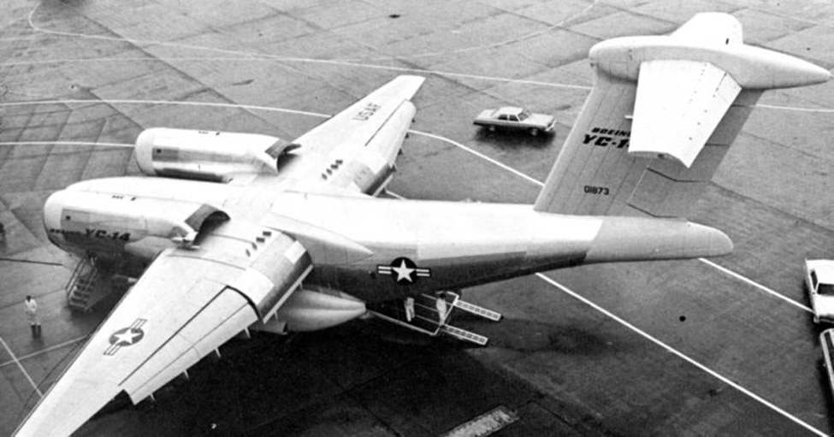
Background
The Boeing YC-14 is an example of circulation control on an aircraft.
The engines blow over special flaps that create a coenda surface, thus creating more lift.

Slide 5
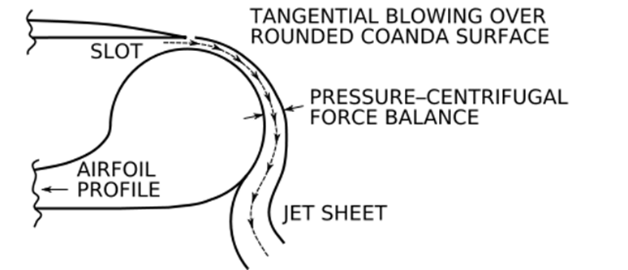
Basic Circulation Control Design
The jet is produced through a small slot that exists across the span of the wing
The flow exits the slot tangentially to the wings surface and flows around the wing until separation

Slide 6
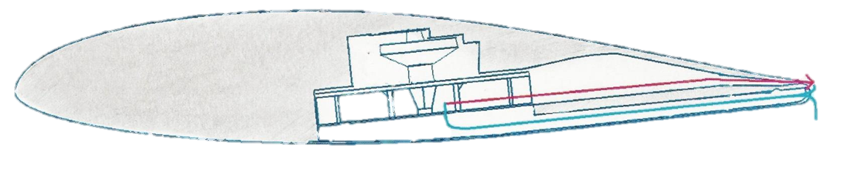
Preliminary Design
The jet is created by a fan inside of the wing.
Flow would be ejected near the top of the trailing edge.
Flow would attempt to be re-ingested through slats on the bottom of the trailing edge.
The red line is the jet out of the wing and the blue line is the air being sucked in.

Slide 7
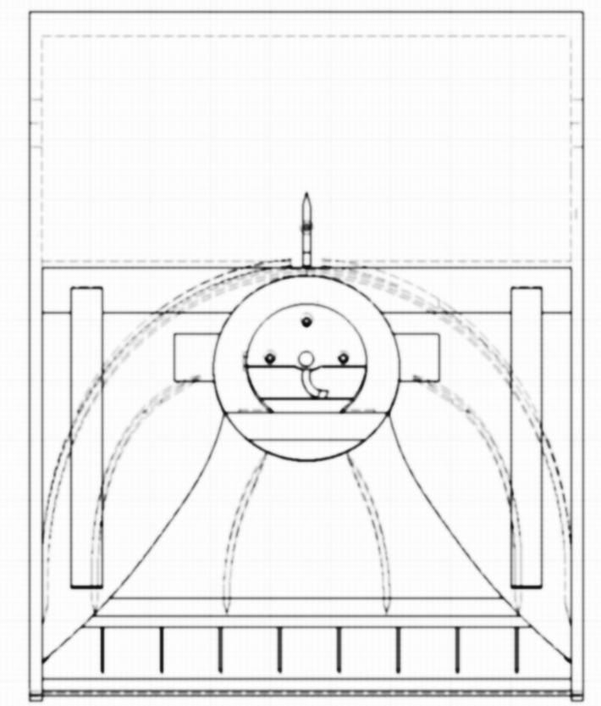
Detail Design
The model was designed using CATIA V5 and rapid prototyped using ABS plastic.
This is a view of our model from CATIA shows the structure inside of the wing.
  Lower Section: consisted of a convergent duct coming from the inlet slots.
  Upper Section: consisted of guide veins coming from the location of the fan. A removable slot was included so the exit profile could be adjusted.

Slide 8
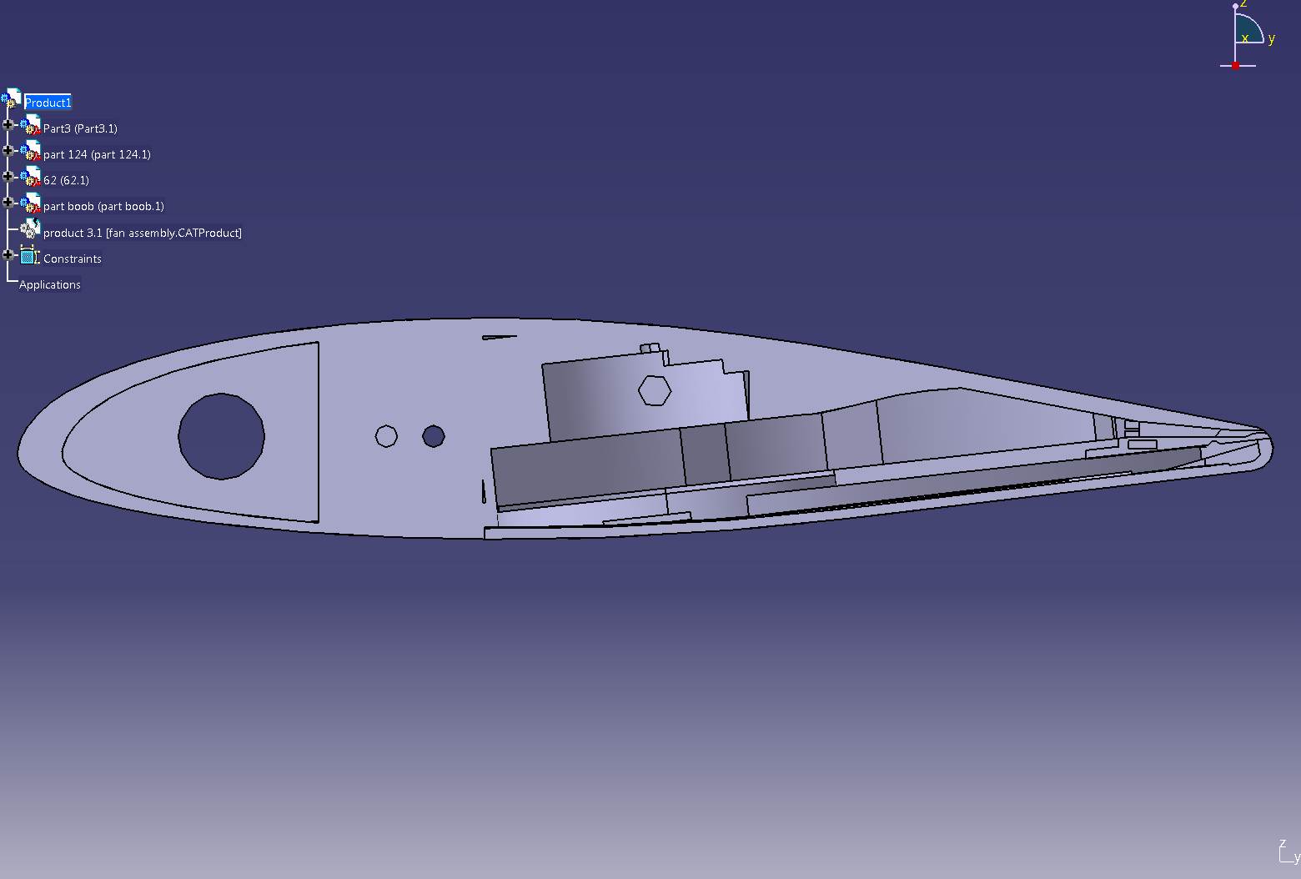
Design
This view shows a cutaway picture of the wing.
  In the middle you can see where the fan was mounted inside of our wing.
  At the trailing edge you can see our slot. During testing the slot had an average height of .3 millimeters.

Slide 9
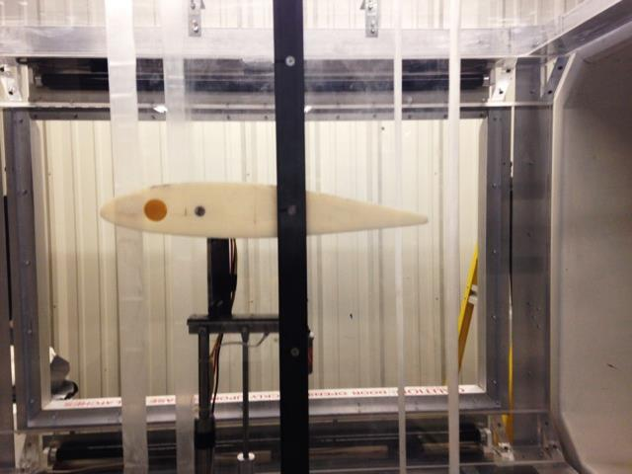
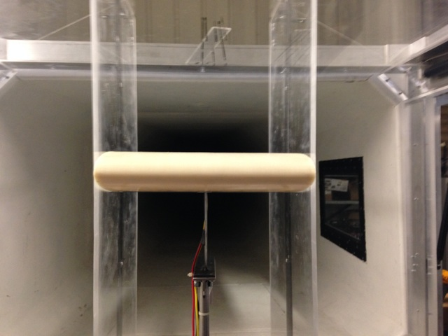
Testing Setup

Slide 10
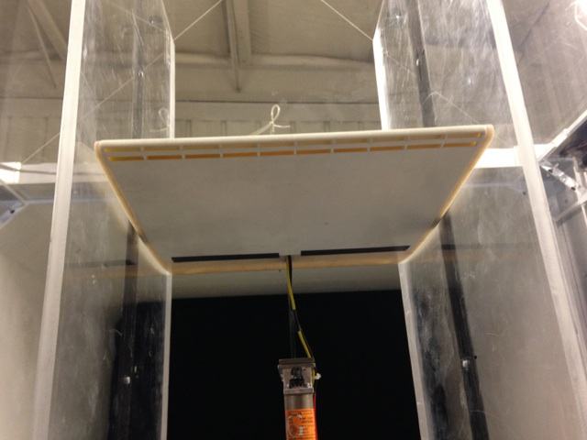
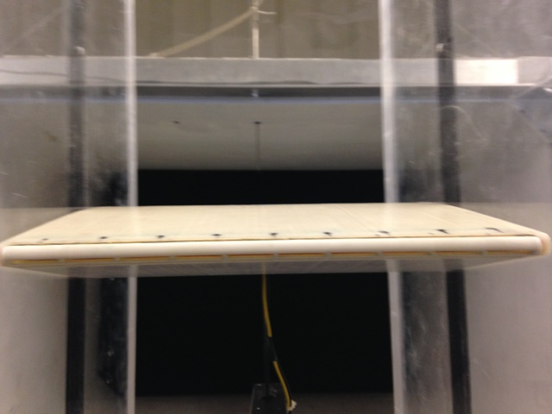
Testing Setup

Slide 11


Testing
Velocity Profile
Cμ Sweep
Alpha Sweep
$$Cμ=\frac{μ}{qs}$$
Nomenclature:
Cμ = Jet momentum Coefficient
μ = $mV_{Jet}=$Jet momentum
m = mass of airflow
$V_{jet}$ = Jet velocity
q = $\frac{1}{2}ρV_{}^{2}=$Dynamic pressure
ρ = Air density
V = incoming velocity
s = Planform area

Slide 12
Testing- Velocity Profile
The first of our tests started with finding a velocity profile.
  This consisted of taking velocity measurements at equidistant points along the span of the slot to see how uniform the velocity across the span was.
  The velocity profile was performed at 5 different rpm’s: 5000, 7500, 10000, 12500 and 15700.
  The velocity profile was averaged for each RPM so that the Cμ values could be calculated

Slide 13
Results - Velocity Profile

Slide 14
Testing – Cμ Sweep
The next step in testing was to do a Cμ sweep. To do this, the wing was set at a constant angle of attack and the motor was run through the same 5 RPM’s tested in the velocity profile. Included in the test was a value with the motor off.
Test Conditions:
  AOA (degrees): 0, 6, 12, 16
  RPM’s: 0, 5000, 7500, 10000, 12500, 15700
  Tunnel Speed (m/s): 14, 18

Slide 15
Results – Cμ Sweep
Tunnel Speed: 14 m/s

Slide 16
Results – Cμ Sweep
Tunnel Speed: 14 m/s
RPM | % Difference (0 Deg) | % Difference (6 Deg) | % Difference (12 Deg) | % Difference (16 Deg)
5000 | -48.0% | -11.4% | -5.8% | -4.4%
7500 | -50.2% | -12.8% | -7.1% | -4.8%
10000 | -41.4% | -8.9% | -6.5% | -3.9%
12000 | -10.8% | -1.5% | -2.5% | -2.5%
15700 | 54.2% | 17.4% | 8.7% | 6.5%

Slide 17
Results – Cμ Sweep
Tunnel Speed: 18 m/s

Slide 18
Results - Cμ Sweep
Tunnel Speed: 18 m/s
RPM | % Difference (0 Deg) | % Difference (6 Deg) | % Difference (12 Deg) | % Difference (16 Deg)
5000 | -29.3% | -6.5% | -4.3% | -4.4%
7500 | -38.7% | -11.0% | -6.8% | -4.2%
10000 | -38.9% | -11.9% | -7.2% | -6.3%
12000 | -17.4% | -6.8% | -6.4% | -4.8%
15700 | 38.8% | 8.6% | 1.6% | 2.4%

Slide 19
Testing- Alpha Sweep
The final tests performed were Alpha Sweeps. These tests were performed at a constant RPM and then run through a series of Angle of Attacks.
Test Conditions:
  Tunnel Speed: 14 m/s, 18 m/s
  RPM: 0 and 15700
  AOA (degrees): -6 degrees to stall in 2 degree intervals.

Slide 20
Results – Alpha Sweep
Tunnel Speed: 14 m/s

Slide 21
Results – Alpha Sweep
Tunnel Velocity: 18 m/s

Slide 22
Results- Alpha Sweep
Tunnel Speed: 18 m/s

